Slide 1
Week 11: EDA Presentation and proposed modeling technique
Amira Esmaeil

Slide 2
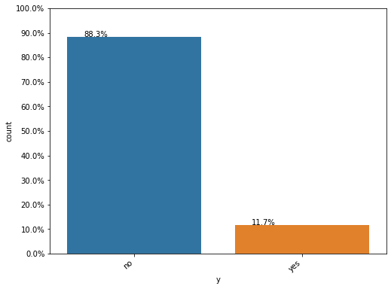
We can see from the above plot that the dataset in imbalanced, where the number of negative class is close to 8 times the number of positive class.

Slide 3
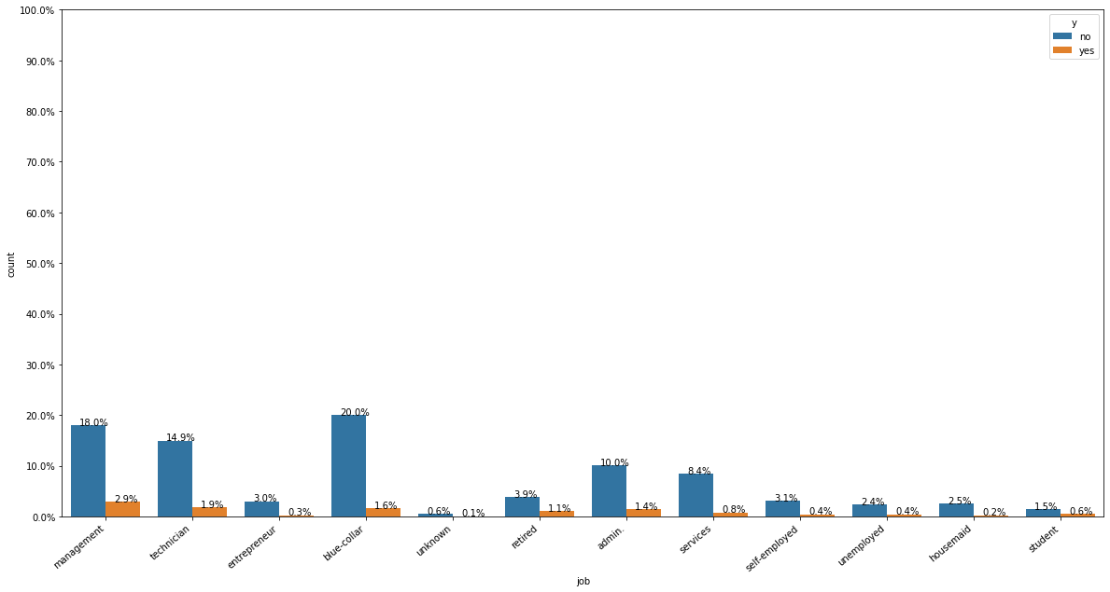
From the above plot, we can see that the customers who have a job of admin have the highest rate of subscribing a term deposit, but they are also the highest when it comes to not subscribing. This is simply because we have more customers working as admin than any other profession.

Slide 4
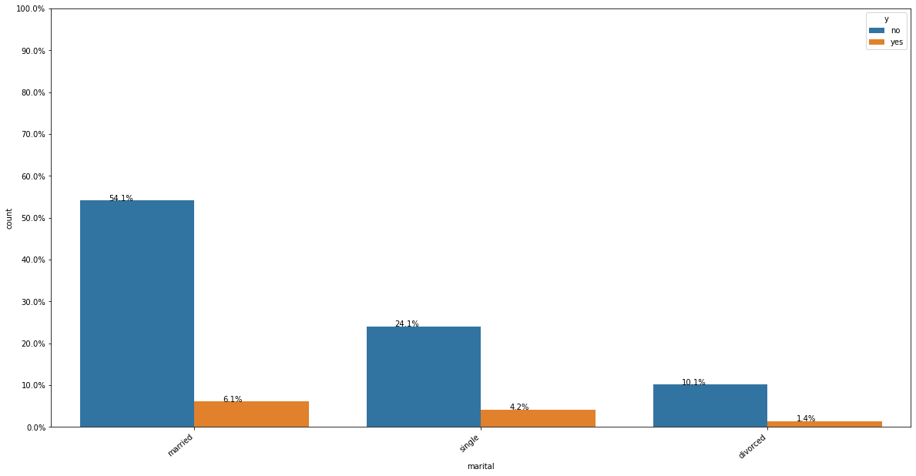
Majority of the customers are married. Followed by Single, divorced and unknown.

Slide 5
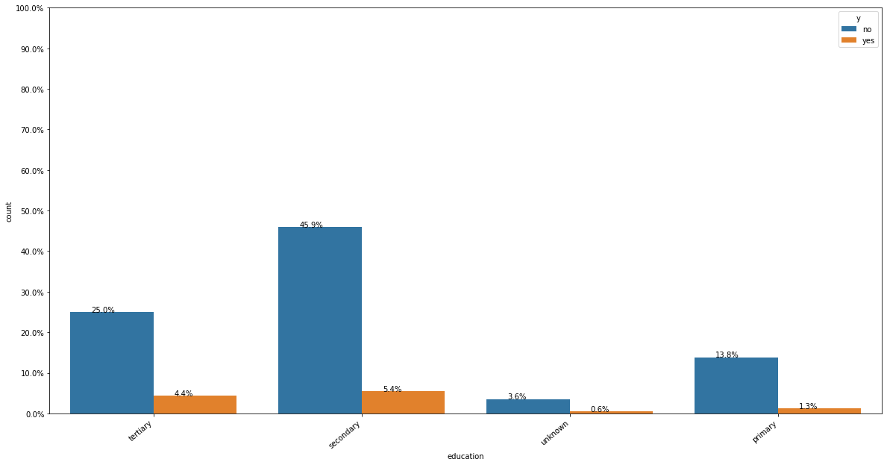
Customers with education is secondary is the highest with yes,so the campaigns should focus on those customers

Slide 6
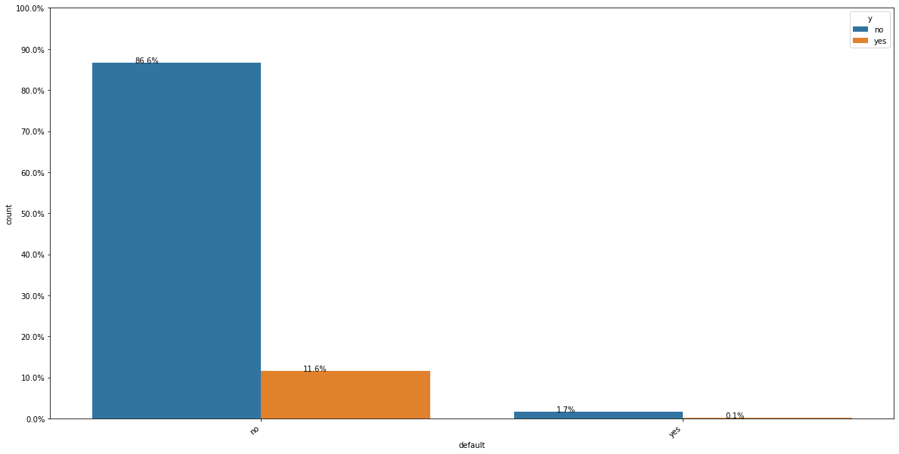
When customers has no credit in default, the customers is likely to buy our product. So the campaign should focus on those customers

Slide 7
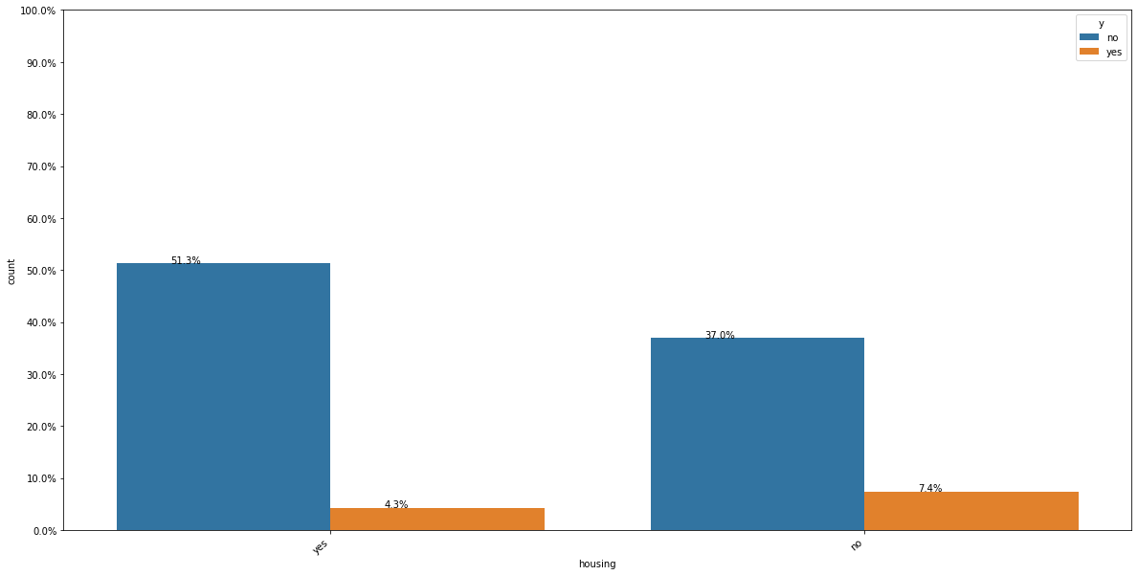
Customers with no housing loans are likely to buy our product

Slide 8
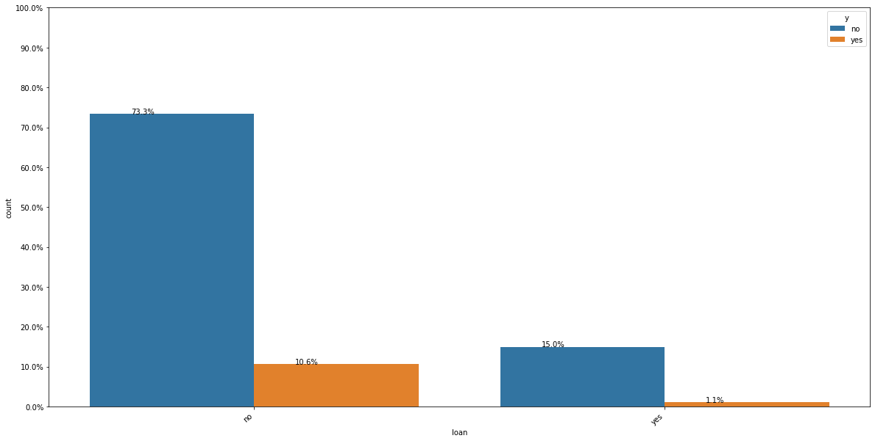
Majority of the customers have a housing loan.

Slide 9
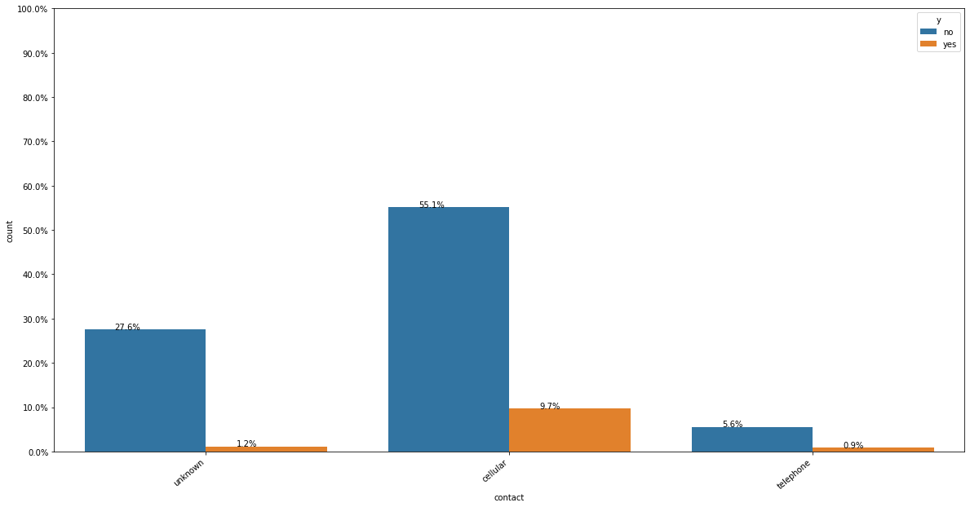
Customers with cellular phones are likely to buy our products

Slide 10
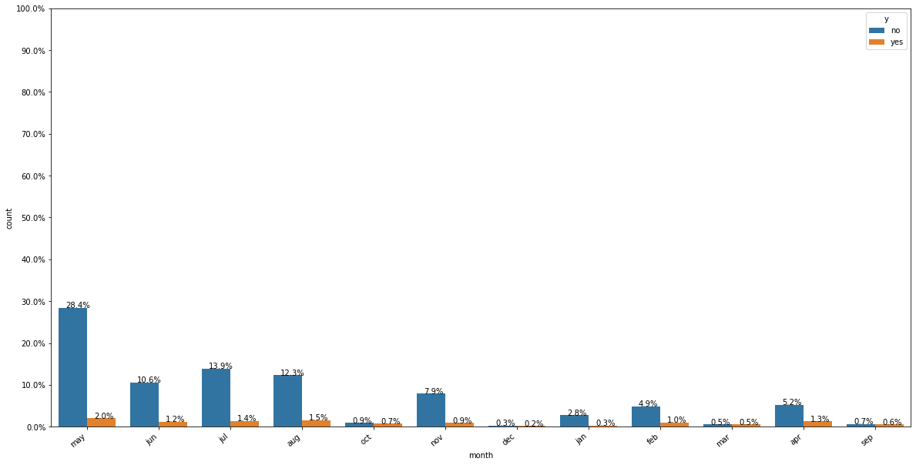
Month distribution for the customer profile

Slide 11
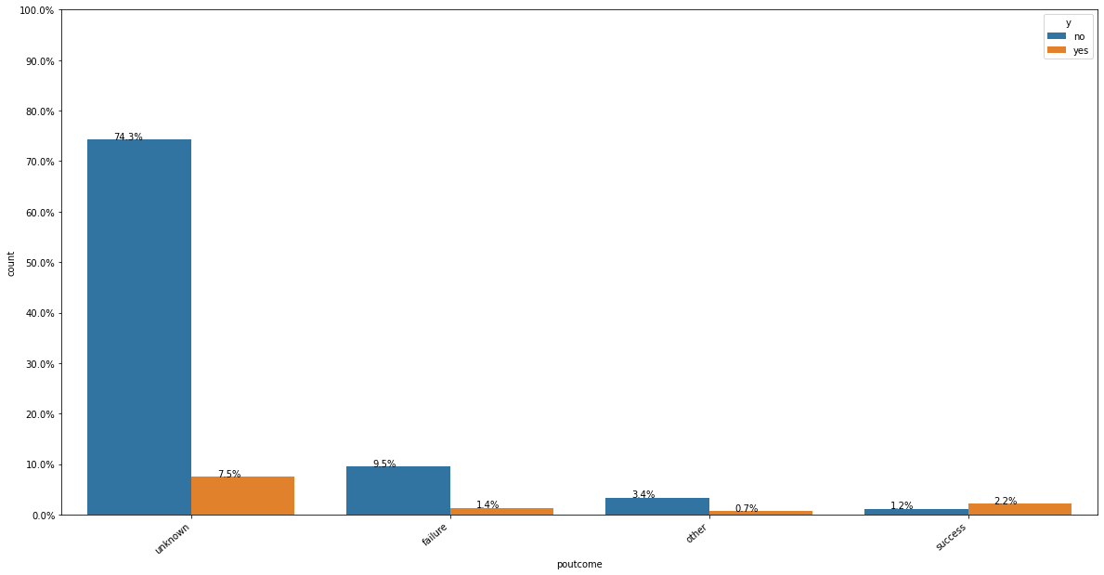
Customers with unknown outcome of the previous marketing campaign is the majority

Slide 12
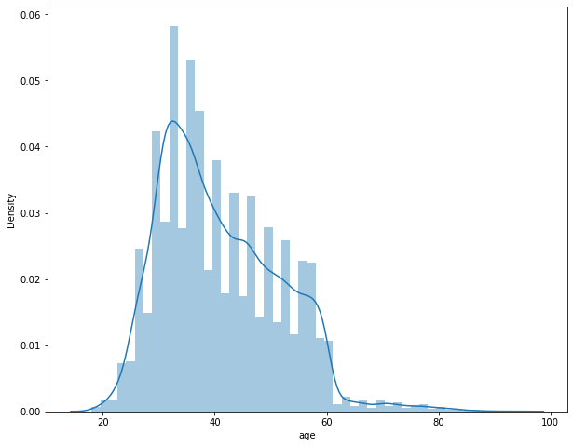
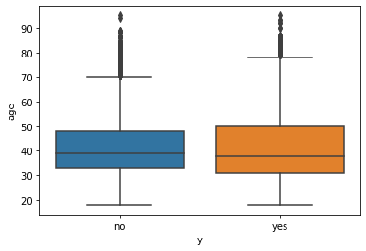
Both the customers that subscribed or didn’t subscribe a term deposit, has a median age of around 38–40. So, the campaign should focus on this age group

Slide 13
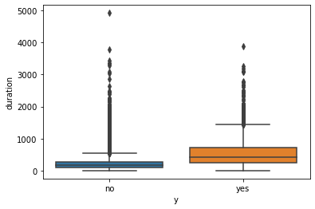
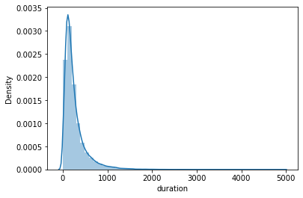
Age and duration are not necessarily a good indicator for which customer will subscribe and which customer will not.

Slide 14
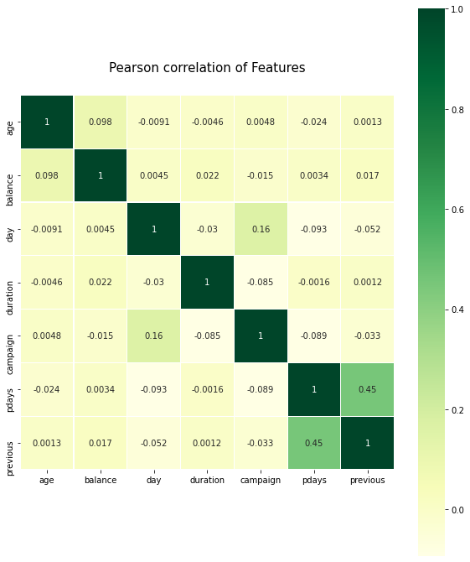
The highest correlation is between pdays (number of days that passed by after the client was last contacted from a previous campaign) and previous (number of contacts performed before this campaign and for this client)

Slide 15
Final Recommendations
The customers who have a job of admin have the highest rate of subscribing a term deposit, but they are also the highest when it comes to not subscribing. So the buiseness should send offers to them.
Majority of the customers are married. Followed by Single, divorced and unknown. The campaign should focus on the married customers
Customers with education is secondary is the highest with yes,so the campaigns should focus on those customers
When customers has no credit in default, the customers is likely to buy our product. So the campaign should focus on those customers
Customers with no housing loans are likely to buy our product
Majority of the customers have a housing loan.
Customers with cellular phones are likely to buy our products
Customers with unknown outcome of the previous marketing campaign is the majority
Both the customers that subscibed or didn’t subscribe a term deposit, has a median age of around 38–40. So, the campaign should focus on this age group
Age and duration are not necessarily a good indicator for which customer will subscribe and which customer will not.

Slide 16
Recommended Models
Logistic Regression
Linear SVM
Random Forest
XGBoost

